Slide 1
GLA Administration
Impact, Wild Apricot,
Google Workspace and More

Slide 2
Agenda
Impact Association Management
Tiers of GLA
GLA Website
Wild Apricot
Google Workspace

Slide 3
GLA’s administrative services company
Impact: Who they are
Contracted initially in May 2019
Email: memberservices@georgialibraryassociation.org
Phone: 912-376-9155
Address: 1502 W Broadway, Ste 102, Madison, WI 53713
Alyssa Merkle, Association Manager & Data Specialist (2021 - )
Emily Heitman, Association Assistant (2022 - )
Managed by the GLA Administrative Services Liaison: adminliaison@georgialibraryassociation.org

Slide 4
GLA’s administrative services company
Impact: Services they provide to GLA
Membership management, updates and correspondence
GLA member listserv
Google groups
Elections
Wild Apricot management
(Contracted for 25 hours per month)

Slide 5
Tier 1: GLA Website https://gla.georgialibraries.org/

Slide 6
Tier 1: GLA Website
Public facing – open to everyone!
Redesigned in 2017
https://gla.georgialibraries.org
General information about GLA
Updated and maintained by the GLA webmaster:
webmaster@georgialibraryassociation.org

Slide 7
Tier 2: Wild Apricot GLA’s membership database

Slide 8
Tier 2: Wild Apricot
Started in October 2019
https://gla1.wildapricot.org/Sys/Login
GLA Members only!
Use the “Sign In” link at the top of the GLA homepage

Slide 9
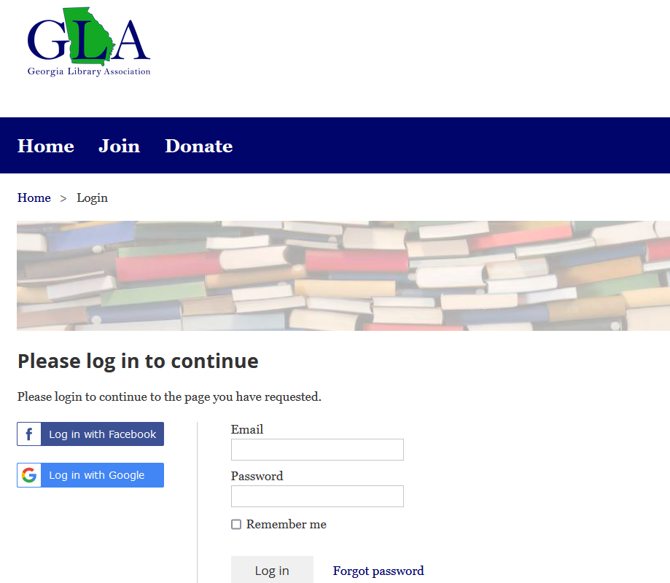
Tier 2: Wild Apricot
Sign In page
The “Email” (username) is the email you used to join GLA

Slide 10
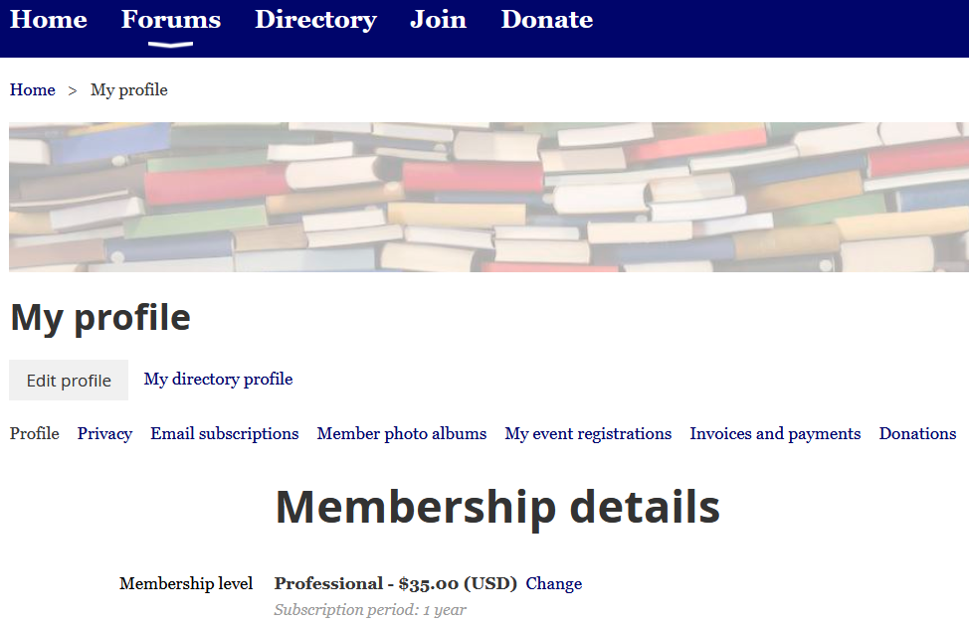
Tier 2: Wild Apricot
To make changes to your profile, click “Edit profile”. Changes include:
Name, Mailing address, Email *, Phone
Type of Library, Institution, Position
Division, Committees, Interest Groups
Opt out, Community Agreement
* NOTE: Your new email will become your new username.
However, this does not change email address in the GLA member listserv – you must email Member Services to do that!
memberservices
@georgialibraryassociation.org

Slide 11
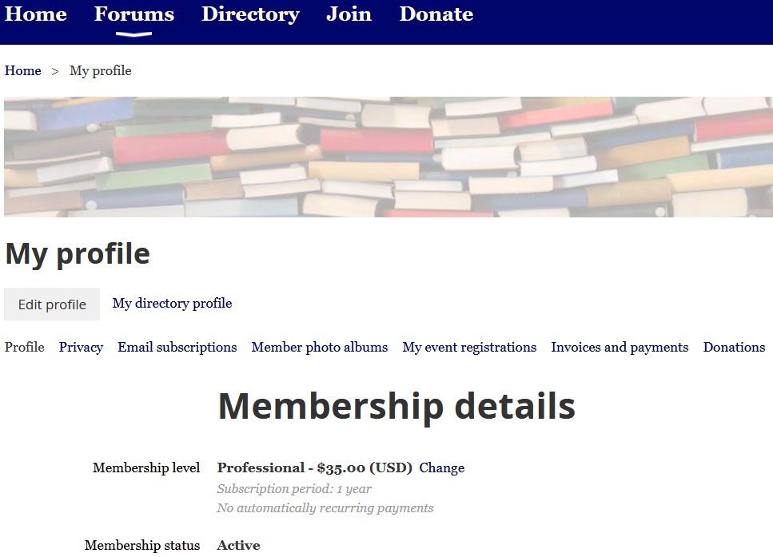
Tier 2: Wild Apricot
Other features:
Event registrations, Invoices, Donations
Membership level (can change this)

Slide 12
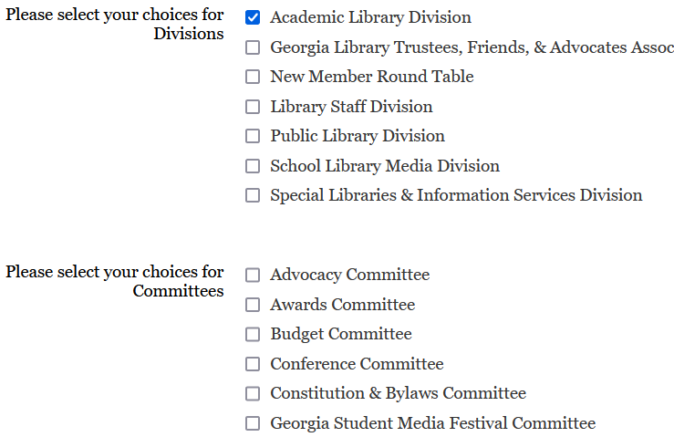
Tier 2: Wild Apricot
“Edit profile” page:
Join or edit your selections for Divisions, Committees and Interest Groups
Impact updates group lists monthly and emails quarterly lists to chairs (i.e. link to download a list).
(Pink: changes in process)

Slide 13
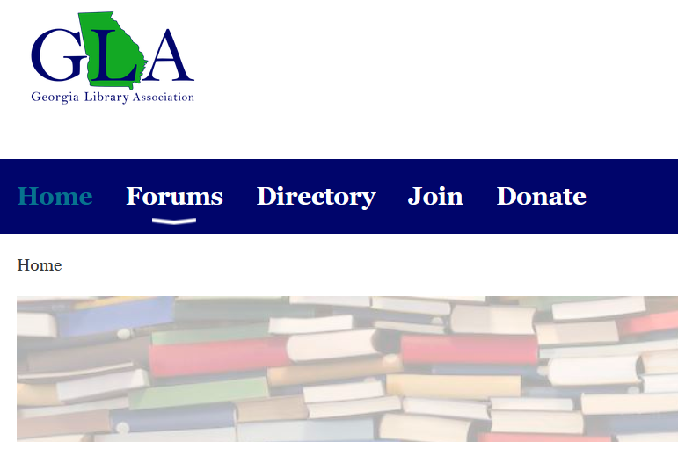
Tier 2: Wild Apricot
Forums
Conversation space for Divisions and Interest Groups.
Directory
Search for members
Join, Donate

Slide 14
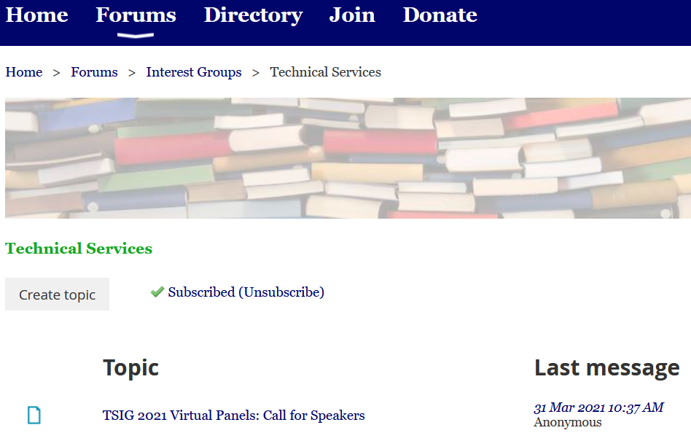
Tier 2: Wild Apricot
Forums
Conversation space for Divisions and Interest Groups
May subscribe to group and/or topic(s) in the group’s forum

Slide 15
Tier 3: Google Workspace
GLA Leadership
communication platform

Slide 16
Tier 3:
GLA Leadership only!
All Divisions, Committees and Interest Groups have:
GLA email account
Google group (listserv)
Google Drive
Google Meets
Shared GLA Calendar
(Look for apps under the “Waffle” / 9 dots / app icon, top/right corner of your account)

Slide 17
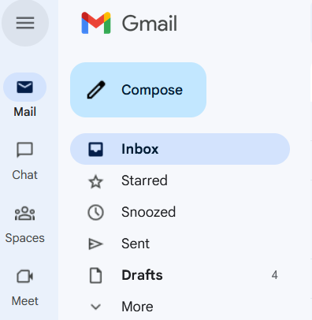
Tier 3:
GLA email account
Email address:
[name]@georgialibraryassociation.org
nmrt@georgialibraryassociation.org
Share account with your officers
Use only for GLA business
To reset your password, email: memberservices@georgialibraryassociation.org

Slide 18
Tier 3:
Google group (listserv)
Listserv address:
[group name]list@georgialibraryassociation.org
nmrtlist@georgialibraryassociation.org
Your group’s listserv email address differs from your GLA email address.
You will receive an email at your personal address with more details.

Slide 19
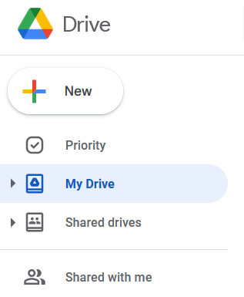
Tier 3:
Google Drive
Use it to store your group’s documents
Have ability to share documents with anyone in GLA and also share with those outside of GLA

Slide 20
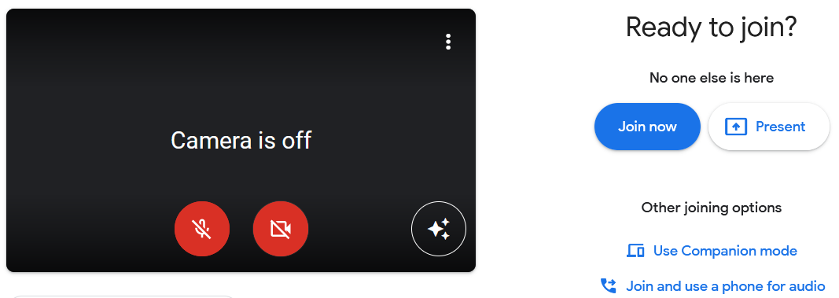
Tier 3:
Google Meets
Use it to meet virtually with your group!

Slide 21
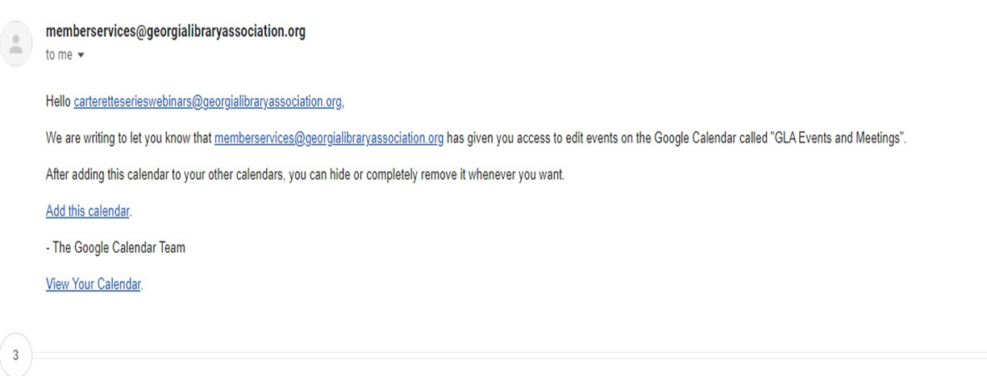
Tier 3:
Google Calendar
GLA leadership has a shared calendar “GLA Events and Meetings”
If it’s not already done by previous chairs, please accept it in an email that you will receive.
You will need to click “Add this calendar”.

Slide 22
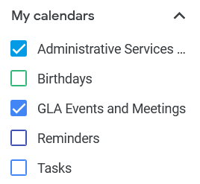
Tier 3:
Google Calendar
Find it under “My calendars”

Slide 23
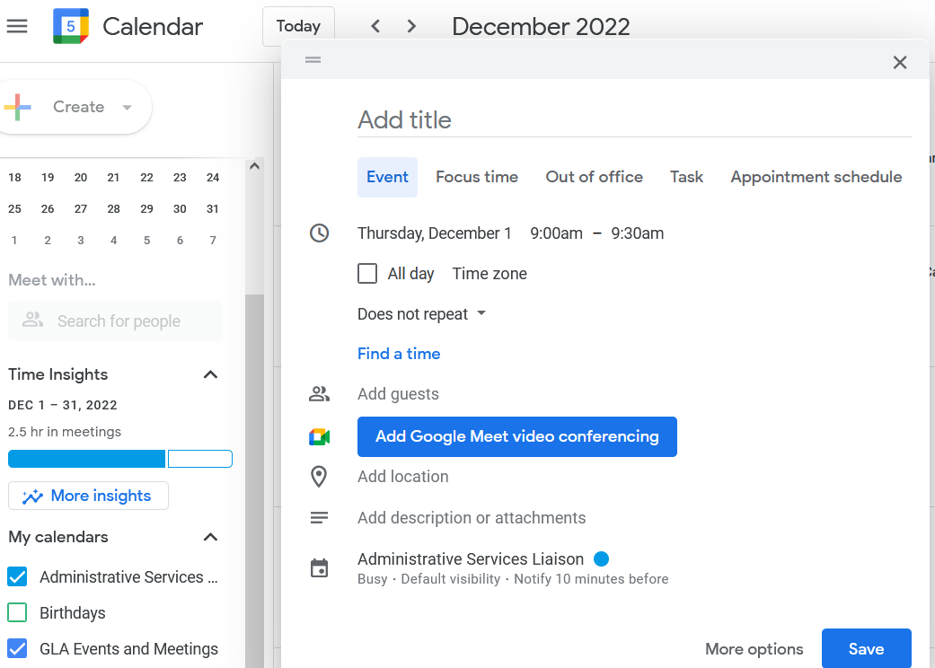
Tier 3:
Google Calendar
Create and add your events!
Only for leaders with GLA email addresses. Not for all GLA members.

